Slide 1

Graph Neural Networks for Social Recommendation
By :-
CHIKATE SATHWIKA
Sangepu Siddhartha
Chinthakunta uday charan

Slide 2
INTRODUCTION
Social networks are developed based on the phenomenon of acquiring and disseminating information through people around us, such as friends and colleagues, and a user's social relationships play an important role in information filtering.
Therefore, it has been proven that properly understanding social relationships helps improve the recommendation performance of models.
Recent studies have shown that Graph Neural Networks (GNNs) can effectively learn the topological structure of graphs.
However, structures like social networks typically involve a combined structure of two types of graphs: one that handles relationships between users and another that deals with relationships between users and items.

Slide 3
A new Graph Neural Network (GraphRec) is proposed, which can be consistently used in social recommendation systems.
It provides an approach that captures both interactions and opinions in the user-item graph.
It introduces a method to mathematically consider heterogeneous strengths.
The efficiency of GraphRec has been validated in various real-world datasets.

Slide 4
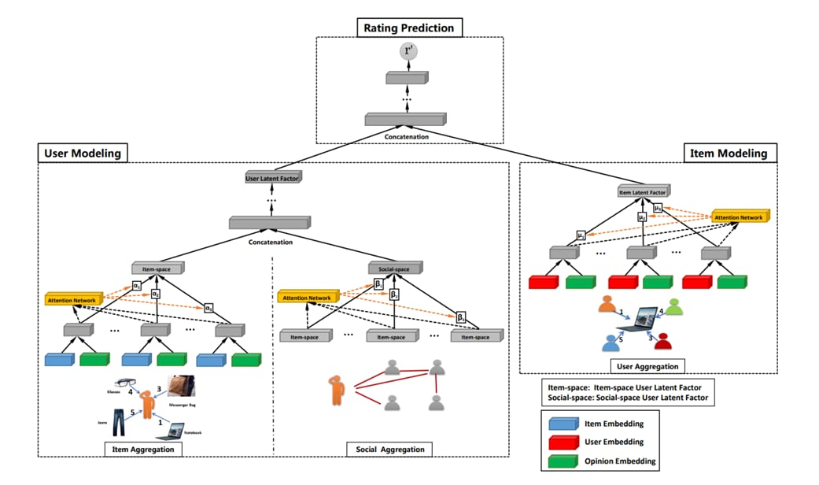

Slide 5
MAIN COMPONENT :-
USER MODELLING:- aim is to learn the user latent factor.
ITEM MODELLING:- aim is to learn the item latent factor.
RATING PREDICTION:-used to learn model parameters. And find relation between user latent factor and item latent factor.
CHALLENGES :-
To combine the user item graph and social graph because in user modelling we have two kinds of things
1.Item aggregation:-item space user latet factor for user is learn from the user item graph.
2.Social aggregation:-social space is a lantent vector is learn from the graph.
Here we have two sort of information one is the user rating on the item and another one is explicit trust relationship between users correlation function.
ARCHITECUTRE-COMPONENTS:-
MULTI LAYER PRECEPTION:- sequcential network(we have two linear layers and onr relu function)

Slide 6
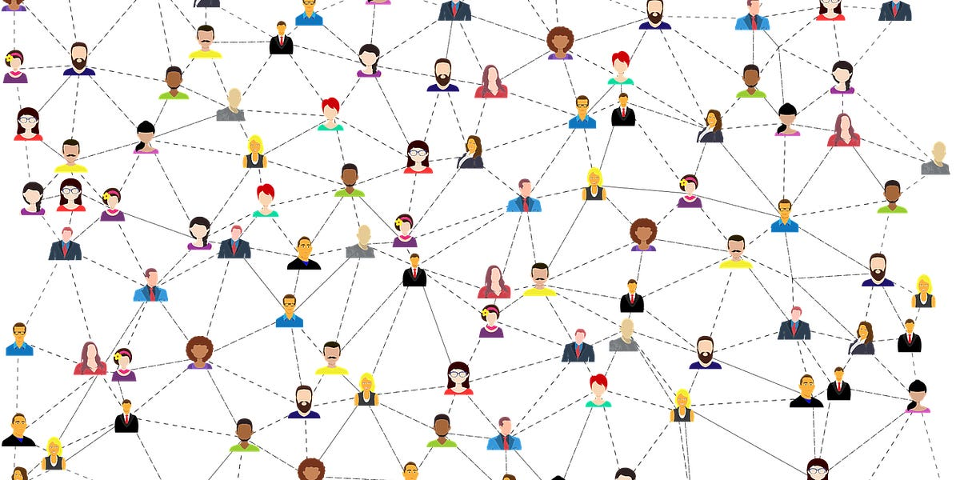
AGGREGATION FUNCTION:-where we same one linear layer and one relu function.
IMPEMET USER MODE COMPONENT:-
ITEM AGGREAGATION-one latent vector
SOCIAL AGGREAGATION:-one social latent factor.

Slide 7
The issue is about how to aggregate information, and it presents several challenges.
1. It involves combining the user-item interaction graph with the user opinion graph to better aggregate information.
2. It's about capturing interactions and opinions between users and items simultaneously.
3. Online, relationships between users can vary. It's important to consider the weighting of these relationships.

Slide 8
CONCLUSION
GraphRec is proposed for rating prediction in the field of social networks, offering a new approach to capture both interactions and opinions in the user-item graph simultaneously.
The experiments in this paper confirmed that opinion information plays a crucial role in improving the performance of the model.
Additionally, it was observed that performance improves when different weights are assigned using anattention mechanism.
This research was based on static data, but since social networks are often static networks, future work aims to develop models that can also be applied to dynamic networks.

